Slide 1
Integrating Open Culture. Practices into Existing Institutional Structures
An HBCU AL$ Summer Series Workshop

Slide 2
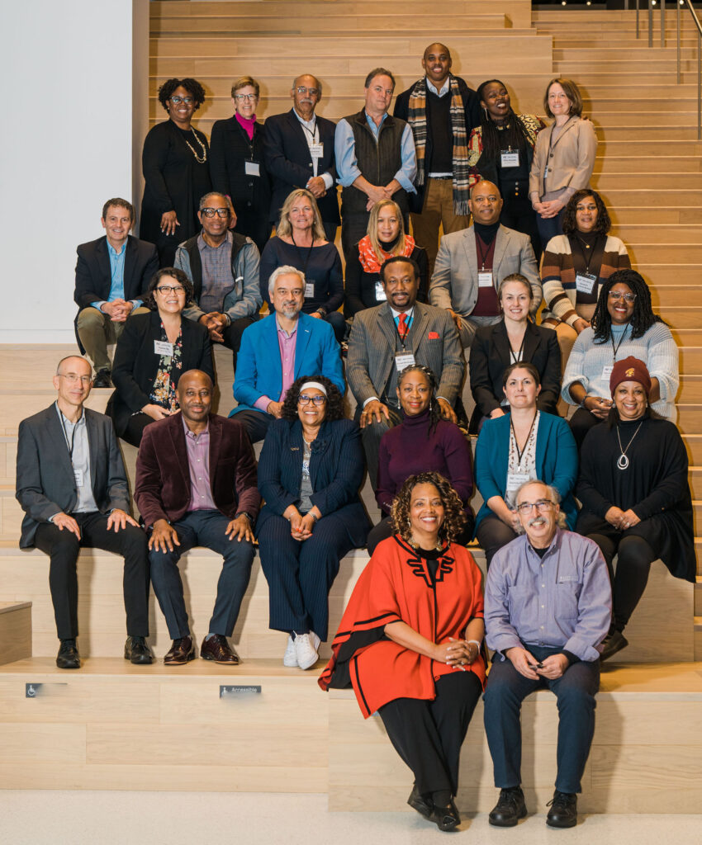
Sustaining Open Cultures in HBCUs
Led by Tennessee State University and supported by the California State University Long Beach MERLOT and SkillsCommons and MIT OpenCourseWare teams, the collaboration and community of Historically Black Colleges and Universities (HBCUs) are designing and deploying strategies making higher education more affordable by reducing the cost of course materials and increasing culturally responsive content.
The HBCU Affordable Learning Solutions (AL$) project provides any HBCU free access to the tools, technologies, and some services for them to initiate their own AL$ program and learn from their HBCU colleagues.
This project is made possible through the essential support from the William and Flora Hewlett Foundation.
Notes:
MERLOT https://MERLOT.org
SkillsCommons. https://SkillsCommons.org
HBCU Community Portal https://www.hbcuals.org/
HBCU Resource Center https://www.merlot.org/merlot/viewSite.htm?id=9162632

Slide 3
Planning is Critical for Creating Campus-Wide Open Culture and Sustaining Implementation
Notes:
Resource Center – Start Here https://www.merlot.org/merlot/viewSite.htm?id=9162632

Slide 4
Agenda
Developing and Sustaining the Open Mindset Campus-Wide
Engaging Stakeholders
Policy Development
Refinement Change Management

Slide 5
Have You Registered Yet? www.MERLOT.org

Slide 6
Dr. Jean Jaques Medastin
Jean-Jacques Medastin, Ph.D. Executive Director ASURams Global Academic Affairs
Albany State University
Albany, GA
jeanjacques.medastin@asurams.edu

Slide 7
First and Most Important Starting Steps
1. Awareness and Advocacy: The first step is to raise awareness about OER among institutional stakeholders, including administrators, faculty, and students. This involves educating them on the benefits of OER, such as cost savings for students, flexibility in course design, and the ability to adapt and customize content to meet specific learning needs.
2. Policy Development: Developing clear institutional policies and guidelines around the use, creation, and sharing of OER is crucial. This ensures a consistent and supportive framework for faculty and staff to adopt and contribute to OER initiatives.
3. Faculty and Staff Engagement: Engaging faculty and staff in the OER implementation process is vital. This includes providing professional development opportunities, resources, and incentives to encourage the adoption and integration of OER into their courses.

Slide 8
4. Content Curation and Creation: Identifying, evaluating, and curating high-quality OER content that aligns with course learning objectives is an important step. Additionally, supporting faculty and staff in the creation of their own OER content can further expand the available resources.
5. Technical Infrastructure: Ensuring the necessary technical infrastructure, such as a content management system or repository, is in place to host, manage, and distribute OER content effectively. This includes considering issues of accessibility, and data privacy.
6. Collaborative Partnerships: Fostering collaborative partnerships with other institutions (AL$ Hub Affiliates and content providers like MIT OpenCourseware), OER repositories, and organizations can help leverage resources, share best practices, and create a robust OER ecosystem.
7. Sustainable Funding and Support: Securing sustainable funding and support for OER initiatives, whether through institutional budgets, grants, or other revenue streams, is crucial for long-term success and scalability.

Slide 9
Ensuring Open and Accurate Communication
Establish
Establish Communication Channels:
Create dedicated communication channels, such as email distribution lists, online forums, or collaboration platforms, to facilitate regular updates, discussions, and feedback.
Encourage two-way communication by providing multiple avenues for stakeholders to voice their concerns, questions, and suggestions.
Designate
Designate Communication Leads:
Appoint dedicated OER communication leads or a steering committee responsible for coordinating and disseminating information.
These individuals or teams should serve as the primary points of contact and be responsible for keeping all stakeholders informed.
Develop
Develop a Communication Plan:
Create a comprehensive communication plan that outlines the target audience, messaging, frequency, and methods of communication.
The plan should address the needs of various stakeholders, including faculty, staff, students, and any external partners such as our Hub affiliates.

Slide 10
Leverage
Leverage Multiple Communication Formats:
Utilize a variety of communication formats, such as email updates, newsletters, webinars, workshops, and face-to-face meetings, to reach different stakeholder groups.
Tailor the communication style and content to the needs and preferences of each audience.
Encourage
Encourage Feedback and Dialogue:
Actively solicit feedback from stakeholders through surveys, focus groups, or open forums.
Respond to inquiries and address concerns in a timely manner to maintain trust and transparency.
Maintain
Maintain Consistent Messaging:
Ensure that all communication materials, including presentations, documents, and online content, convey a consistent message and align with the institution's OER goals and objectives.
Provide training or resources to help stakeholders communicate effectively about OER initiatives.
Leverage
Leverage Existing Communication Channels:
Utilize existing communication channels within the institution, such as faculty meetings, staff newsletters, or student information portals, to disseminate OER-related updates.
This can help integrate OER communication into the existing institutional communication ecosystem.

Slide 11
Assessing Readiness Levels
Stakeholder Surveys and Interviews:
Conduct surveys and interviews with key stakeholders, including faculty, staff, and students, to gauge their awareness, attitudes, and level of engagement with OER.
Gather information about their current usage of OER, any barriers or challenges they face, and their perceived needs for support.
Environmental Scan:
Perform an environmental scan to understand the institution's existing infrastructure, policies, and resources related to OER.
Assess the availability of technical platforms, content repositories, faculty development programs, and any other OER-related initiatives.
Readiness Assessment Framework:
Develop or adapt a readiness assessment framework that covers various dimensions of OER implementation, such as leadership support, faculty engagement, content availability, and technical capacity.
Use this framework to evaluate the institution's current state and identify areas that require more attention or support.

Slide 12
Maturity Model Analysis:
Utilize a maturity model approach to assess the institution's level of OER adoption and implementation.
This can help identify the current stage of the institution (e.g., awareness, exploration, adoption, or institutionalization) and inform the necessary next steps.
Gap Analysis:
Conduct a gap analysis to identify the discrepancies between the desired state of OER implementation and the current state.
This analysis can help prioritize the areas that need the most support, such as professional development, content curation, or technical infrastructure.
Pilot Programs and Feedback Loops:
Implement pilot OER initiatives in specific departments or courses to gather real-world feedback and insights.
Use the lessons learned from these pilots to refine the support and resources needed for broader implementation.
Benchmarking and Peer Learning:
Engage with other institutions that have successfully implemented OER to learn from their experiences, best practices, and the support mechanisms they have in place.
Benchmark the institution's progress against these peer institutions to identify areas for improvement.

Slide 13
Support for Faculty and Staff for an AL$ Effort?
Awareness and Engagement:
Provide comprehensive awareness and education campaigns to inform faculty and staff about the benefits of OER and the HBCU AL$ initiative.
Organize interactive workshops, webinars, and information sessions to engage faculty and staff and address their concerns or questions.
Faculty Development and Training:
Offer sustained professional development opportunities for faculty to learn about finding, evaluating, adapting, and integrating OER into their courses.
Provide training on topics such as copyright, Creative Commons licenses, and effective OER practices.
Instructional Design Support:
Assign instructional designers or educational technology specialists to work closely with faculty in redesigning courses using OER.
Assist faculty in aligning OER content with course learning objectives and ensuring pedagogical effectiveness.

Slide 14
Content Curation and Repositories:
Develop or curate a centralized repository of high-quality, vetted OER content that is relevant to the HBCU curricula.
Provide easy-to-use search and discovery tools to help faculty access and identify appropriate OER materials.
Peer Mentoring and Learning Communities:
Establish faculty learning communities or peer mentoring programs to facilitate the exchange of best practices, lessons learned, and collaborative problem-solving.
Encourage faculty to share their experiences and provide peer-to-peer support in adopting and using OER.
Incentives and Recognition:
Offer incentives, such as course release time, professional development funding, or recognition in the tenure and promotion process, to encourage faculty participation and contributions to the HBCU AL$ effort.
Acknowledge and celebrate faculty champions who have successfully implemented OER in their courses.
Technical and Administrative Support:
Provide IT and technical support to assist faculty in integrating OER into their course materials and learning management systems.
Offer administrative support for tasks like copyright clearance, metadata tagging, and the publishing of OER content.
Content Curation and Repositories:
Develop or curate a centralized repository of high-quality, vetted OER content that is relevant to the HBCU curricula.
Provide easy-to-use search and discovery tools to help faculty access and identify appropriate OER materials.
Peer Mentoring and Learning Communities:
Establish faculty learning communities or peer mentoring programs to facilitate the exchange of best practices, lessons learned, and collaborative problem-solving.
Encourage faculty to share their experiences and provide peer-to-peer support in adopting and using OER.
Incentives and Recognition:
Offer incentives, such as course release time, professional development funding, or recognition in the tenure and promotion process, to encourage faculty participation and contributions to the HBCU AL$ effort.
Acknowledge and celebrate faculty champions who have successfully implemented OER in their courses.
Technical and Administrative Support:
Provide IT and technical support to assist faculty in integrating OER into their course materials and learning management systems.
Offer administrative support for tasks like copyright clearance, metadata tagging, and the publishing of OER content.

Slide 15
Dr. Arletha McSwain
Arletha McSwain, PhD
Vice Provost Access & Enrollment Management
Central State University
Wilberforce, OH
amcswain@centralstate.edu

Slide 16
Dr. Arletha McSwain
What communication tools appear to be the most useful when communicating project status with senior staff?
Do you use separate tools to communicate project successes?
In your experience, which players (roles) have had the greatest level of impact regarding providing support for the HBCU AL$ Open Culture project.
Do you have recommendations for newcomers who may be seeking to increase engagement and thus support from senior staff?

Slide 17
Dr. Clarissa West-White
Clarissa West-White, Ph.D.
University Archivist & Assistant Professor,
Carl S. Swisher Library FACRL Past President & Board Member, FACRL | Robert F. Smith Fellow​​ | Key West Literary Seminar Fellow​ Bethune-Cookman University
Daytona Beach, FL
whitec@cookman.edu

Slide 18
Where do you find small wins?

Slide 19
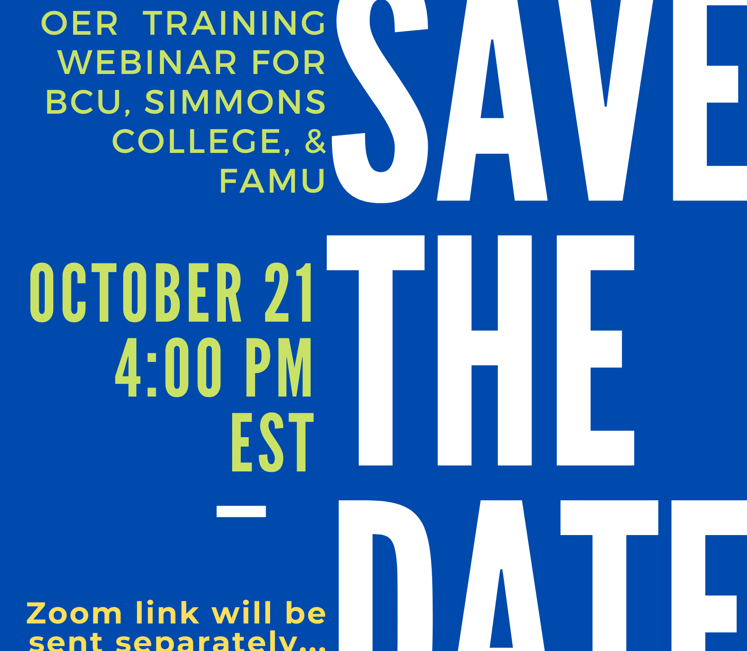
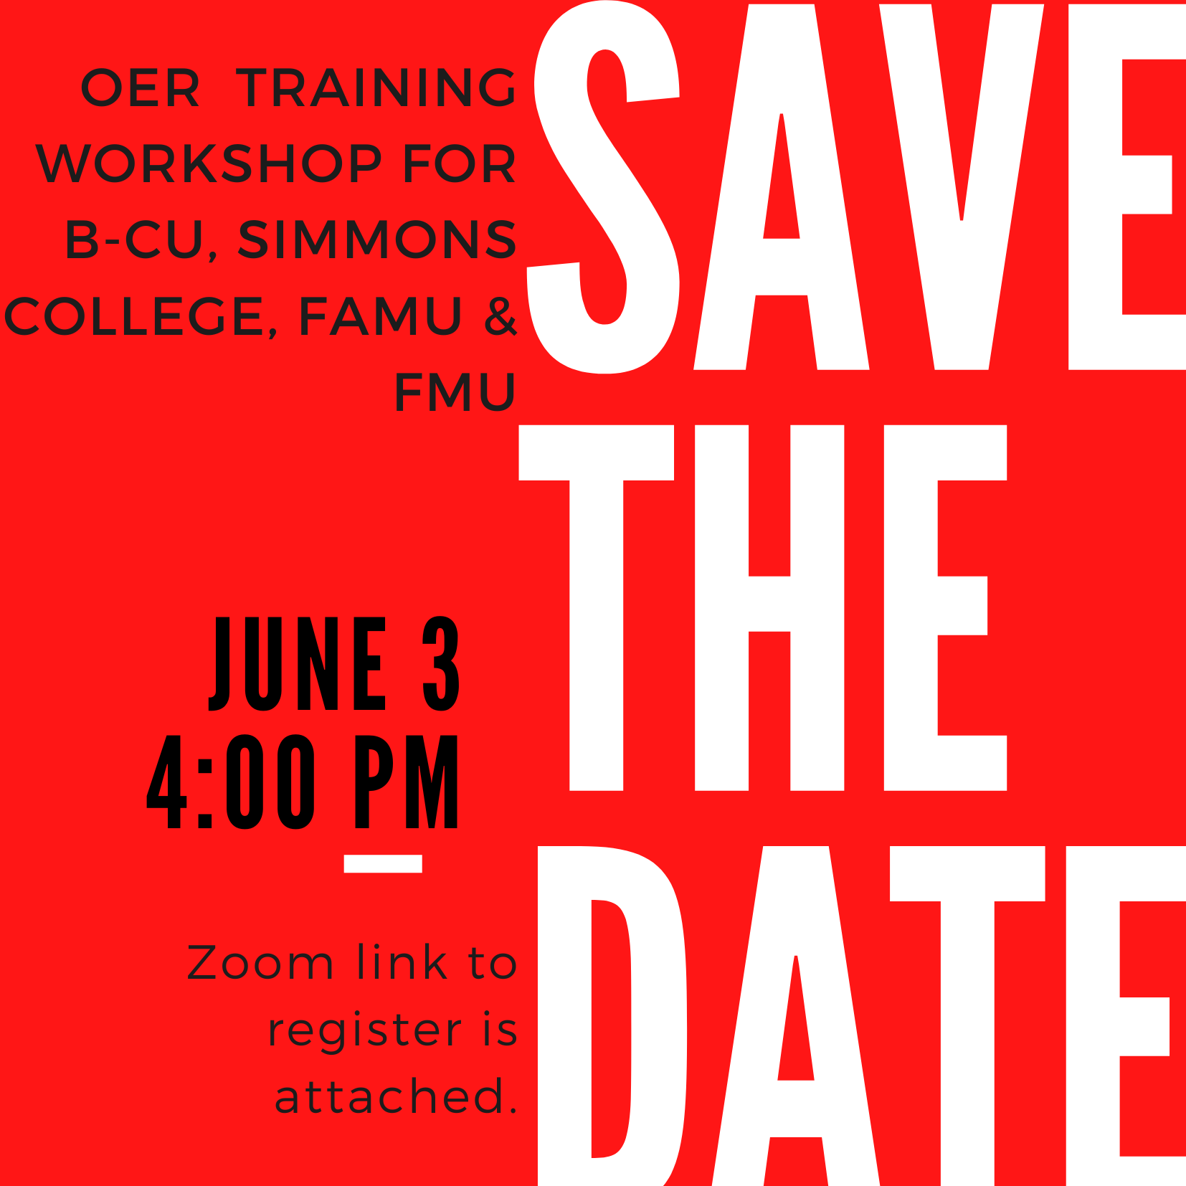
Faculty Connections

Slide 20
How do you choose to celebrate those small steps?

Slide 21
Give Faculty What They Need (even if they do not know they need it)

Slide 22
At what point do small wins become the more impactful pieces, and how do you know if/when you are there?

Slide 24
What do you find to be the most successful ways to build buy-in at the campus level? Get faculty involved?

Slide 26
Next Workshop: July 23rd, 2024 3:00 – 4:00 pm CT Register Here! https://www.merlot.org/merlot/viewSite.htm?id=9162632&pageid=9185394
Notes:
Workshop 3 of 5

Slide 27
Questions

Slide 28
Questions?
WebMaster@MERLOT.org
Support@SkillsCommons.org
Rick Lumadue: Director, MERLOT - SkillsCommons
Maria Fieth: Director, MERLOT - SkillsCommons
This work is licensed under a Creative Commons Attribution 4.0 International License.
Notes:
Maria.fieth@csulb.edu

